Slide 1
Machine Learning
© Templateswise.com
Miles per Gallon Model
Notes:
Source: https://www.templateswise.com/electric-car-powerpoint-template/

Slide 2
Purpose
Create a model to predict MPG of a gasoline powered vehicle given a limited number of parameters

Slide 3
Project Overview
Data Source
ETL: Clean, Preparing & Manipulating Data
Data Visualization & Tableau
Model Development & Deployment
Conclusion/Improvements
Kevin
Kevin
Albert
Greg
Greg & Ryan
1
2
3
4
5

Slide 4
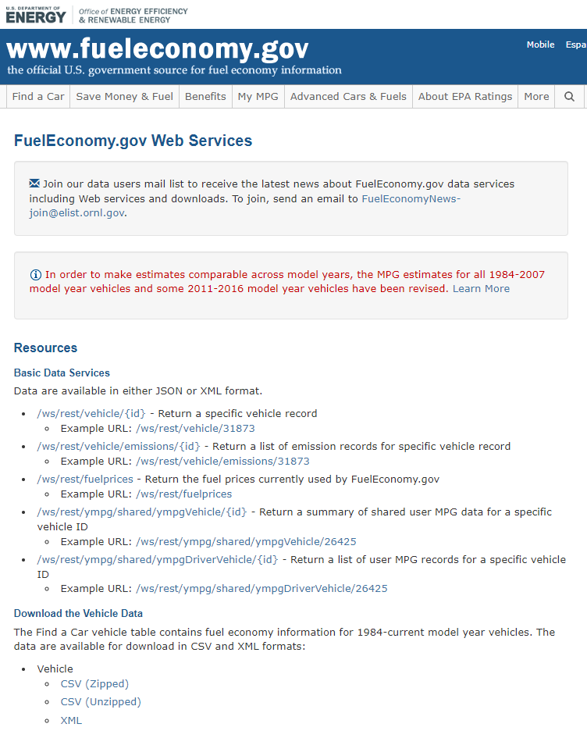
Data Source: EPA
U.S. Department of Energy
FuelEconomy.gov Web Services
Vehicle Data
46,000 vehicles
84 columns
1984-2023
Link: https://www.fueleconomy.gov/feg/ws/#fuelType2

Slide 5
Data ETL
Filtered out
All vehicle not run solely on gasoline
Hybrids
2 cylinder removed as mostly rotary engine cars
Removed Special Purpose Vehicles as covered a too wide range of vehicle types
Reduced
Columns to 7 after all filtering
MPG(target), Cyl, Disp, VehicleClass, Trany, Drive, Year
Years from 1984 to 2023 to 2000 to 2023 as gave better predictions

Slide 6
Tableau Presentation
https://public.tableau.com/app/profile/albert.dudek/viz/Project_4_MPG_Prediction/MPGbyYear?publish=yes
Notes:
Source: https://www.templateswise.com/electric-car-powerpoint-template/

Slide 7
Model Development
Notes:
Source: https://www.templateswise.com/electric-car-powerpoint-template/

Slide 8
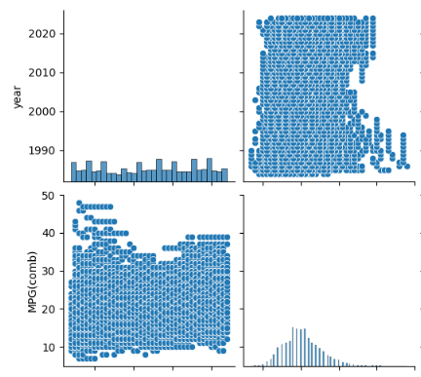
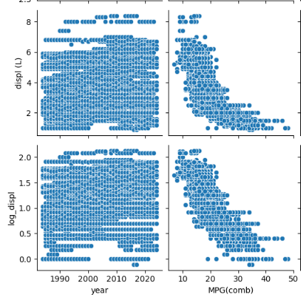
Machine Learning Model
Response is a continuous quantity, so regression is an appropriate technique
More data transformation
Remove years before 2000
Transform displacement using natural logarithm
ln(disp)
Notes:
Source: https://www.templateswise.com/electric-car-powerpoint-template/

Slide 9
Machine Learning Model
Multiple linear regression
Vehicle class, drive, and transmission were one-hot encoded
Year, # cylinders, and displacement were scaled
Train_test_split was used to make training and testing data
Polynomial regression
Sklearn PolynomialFeatures and LinearRegression were wrapped in a pipeline and fit using the training data
Model evaluations
R² and RMSE used to evaluate predictive ability
Residuals were checked for uniformity and normality
Randomly sample and process original data to make new predictions
Notes:
Source: https://www.templateswise.com/electric-car-powerpoint-template/

Slide 10
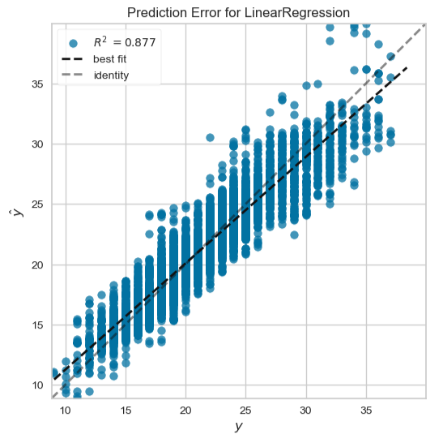
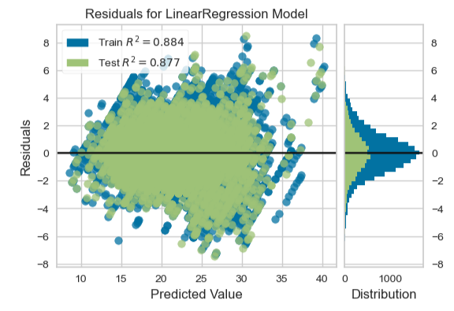
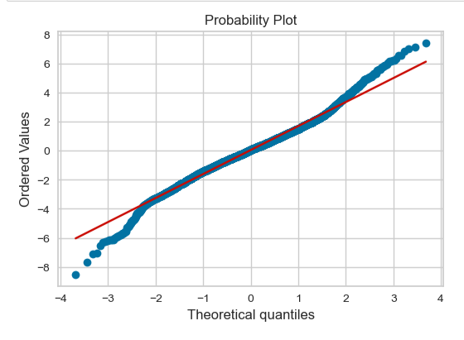
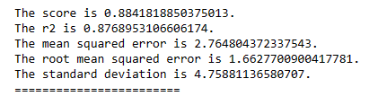
Model Evaluation
(R² = 0.84 for linear model)

Slide 11
Model
Deployment
Notes:
Source: https://www.templateswise.com/electric-car-powerpoint-template/

Slide 12
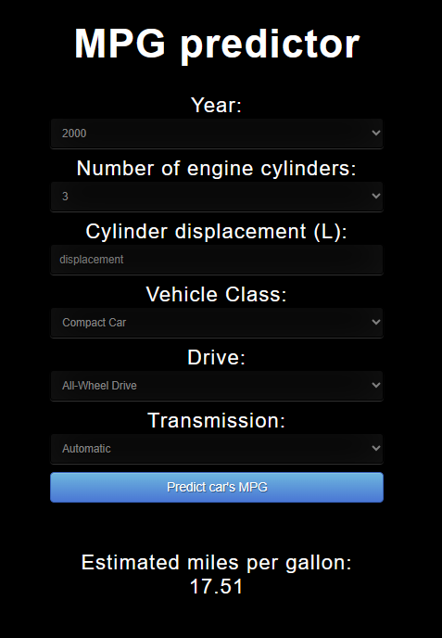
Model Deployment
Model and scaler were exported/imported using the Pickle library
Flask API used to deploy the model
User interfaces with Flask through HTML/JS/CSS to input vehicle specs, then the dashboard returns an mpg prediction

Slide 13
Conclusions
&
Improvements
Notes:
Source: https://www.templateswise.com/electric-car-powerpoint-template/

Slide 14
Conclusions
Smaller class vehicles were harder to predict than larger vehicles, due to smaller vehicles having a greater range of MPG compared to larger vehicles.
Roughly 50% of cars fall between 17 and 23 MPG.
Generally, Front-Wheel Drives have a higher MPG than 4-Wheel (All-Wheel) and Rear-Wheel Drives.
Generally, fewer cylinders corresponds to greater MPG. A similar phenomena can be found in L(displacement).
Notes:
Source: https://www.templateswise.com/electric-car-powerpoint-template/

Slide 15
Improvements
Adding the weight and horsepower for each vehicle
Functionality of the dashboard
Notes:
Source: https://www.templateswise.com/electric-car-powerpoint-template/
Adding the weight and horsepower for each vehicle
Unable to find a weight/horsepower for each vehicle
Functionality of the dashboard
Unable to

Slide 16
Questions?
Notes:
Source: https://www.templateswise.com/electric-car-powerpoint-template/

Slide 17
The End
© Templateswise.com
Notes:
Source: https://www.templateswise.com/electric-car-powerpoint-template/

